Slide 1
Lab 5
Autologistic Actor Attribute Models (ALAAMs)
(Bayesian Version, using R)

Slide 2
Autologistic Actor Attribute Model (ALAAM)
ALAAM predicts node attributes based on fixed ties
Models actor behaviors - node attribute becomes dependent variable
  While ERGMs predict network ties based on node attributes, ALAAM predicts node attributes based on network ties
Allows for the modeling of social influence processes
  How friendship among teenagers (network ties) may influence whether they smoke (node attribute)
Effects in ALAAM: network position, network attribute, covariate
Daraganova, G., & Robins, G. (2013). Autologistic actor attribute models. Exponential random graph models for social networks: Theory, methods and applications, 102-114.

Slide 3
What you need for Lab 5
The main R script: Lab5_ALAAM.qmd
Data files:
  WCOM_US.csv
  WCOM_China.csv
  attributes_US.csv
  attributes_China.csv

Slide 4
Data
Data¹: 200 employees across 31 organizational teams in the U.S. & China
Focal attribute: Knowledge hiding behavior (1 = frequently²; 0 = otherwise)
Other attributes: age, gender, education-level, tenure with current team, outdegree
Directed ties: Communication for work-related purposes (1 = frequently²; 0 = o.w.)
Assignment Goal: Use Bayesian ALAAM to predict employees’ tendency to hide knowledge from their team members based on their workplace communication network and other attributes
(1) Data collected by Prof. Chunke Su, Univ. of Texas at Arlington
(2) Frequency is binarized based on the within-team mean

Slide 5
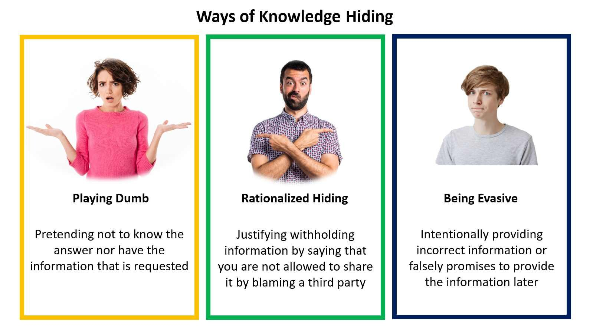
What is Knowledge Hiding?
Focal attribute: Knowledge hiding behavior (1 = frequently²; 0 = otherwise)

Slide 6
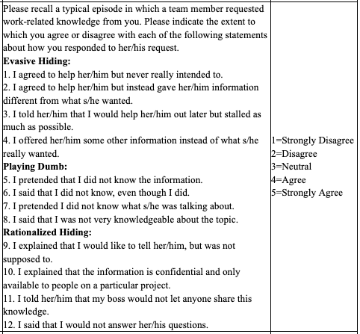
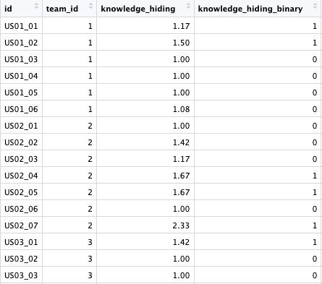
Binarizing Knowledge Hiding
Focal attribute: Knowledge hiding behavior (1 = frequently²; 0 = otherwise)

Slide 7
Binarizing Knowledge Hiding
Focal attribute: Knowledge hiding behavior (1 = frequently²; 0 = otherwise)
Team 3’s mean knowledge hiding tendency = 1.14
→ threshold for assigning 0/1 knowledge hiding values

Slide 8
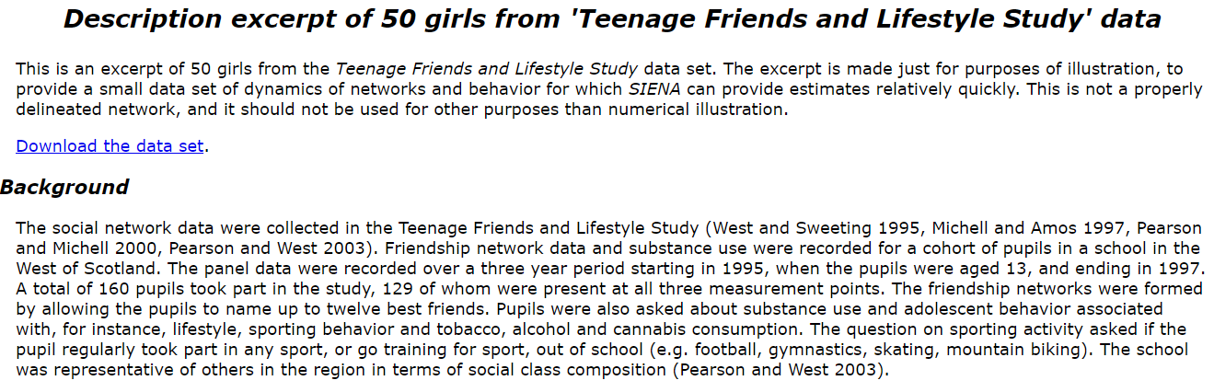
Data
50 girls from first wave of the ‘Teenage Friends & Lifestyle Study’
  Focal attribute: smoking (1 = regularly; 0 = otherwise)
  Other attributes: sport & alcohol (1 = regularly; 0 = otherwise)
  Friendship ties (1 = friendship from a girl to another; 0 = otherwise)

Slide 9

Hypotheses
Hypothesis 1: There is a positive contagion effect for knowledge hiding.
DV: knowledge hiding
IV: alter’s knowledge hiding
A positive relation b/w IV and DV

Slide 10
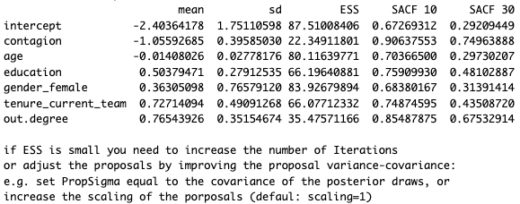
Model 0 - initial contagion model

Slide 11
Model 0 - initial contagion model
Estimates (𝛉) are log-odds ratios

Slide 12
Model 0 - initial contagion model
Standard deviations associated with the estimates

Slide 13
Model 0 - initial contagion model

Slide 14
Model 0 - initial contagion model
What is ESS?

Slide 15
What is Effective Sample Size (ESS)?
Like ERGMs, ALAAM draws networks samples from a Markov Chain Monte Carlo (MCMC) simulation. These samples are not independent and can be highly correlated among themselves.
After this model calculated 1,000 of MCMC samples, we want to see how many of these samples are independent.
In statistics, ESS is a heuristic to measure how many of these MCMC samples are independent.
  If all samples are correlated, ESS = 1. (One sample is worth it)
  If all samples are not correlated, ESS = 1,000. (All the samples are worth it)

Slide 16
What is Effective Sample Size (ESS)?
How is ESS calculated?
  If all samples are independent (p = 0), then ESS = n
  If all samples are dependent (p = 1), then ESS ~ 1
What ESS is adequate?
  The larger the better. > 100 would be good, > 200 would be better. Chasing ESS > 10,000 may be a waste of computational resources.

Slide 17
Model 0 - initial contagion model

Slide 18
Model 0 - initial contagion model
What is SACF 10 and SACF 30?

Slide 19
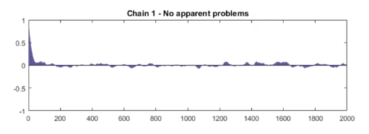
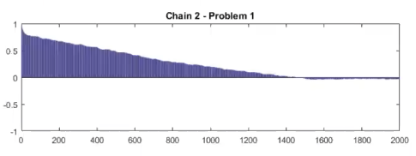
What is SACF?
The Sample Autocorrelation Function (SACF) indicates to what extent every lag sample draw is autocorrelated or correlated with the previous lag.
Chain 1 shows that autocorrelation is large at short lags, but then goes to zero pretty quickly
Chain 2 shows that autocorrelation is not only large at short lags, but also dies out very slowly.

Slide 20
What is SACF?
What we want for SACF: lower is better
  SACF 10: We pick every 10th draw of 1,000 MCMC iterations.
    How are these draws autocorrelated? Ideally, it should be < .70 for each variable
  SACF 30: We pick every 30th draw of 1,000 MCMC iterations.
    Ideally, it should be < .30 for each variable

Slide 21
Model 0 - initial contagion model

Slide 22
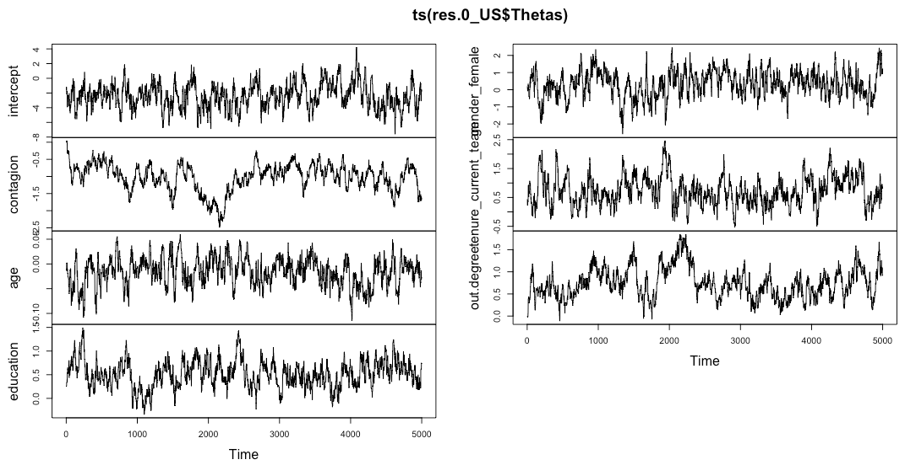
Where is ESS/SACF from?
Estimates (𝛉)
MCMC sample

Slide 23
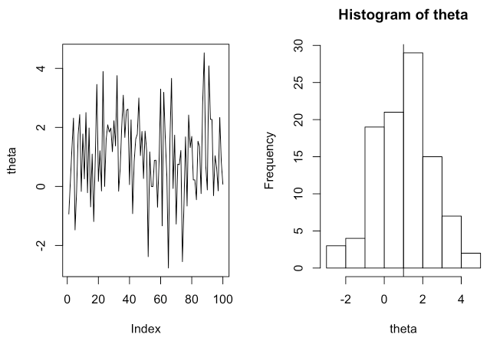
Good Trace Plot
The draws here randomly fluctuate around the mean (1.5). If we project the draws to a histogram, this shows us a normal distribution centered around 1.5.

Slide 24
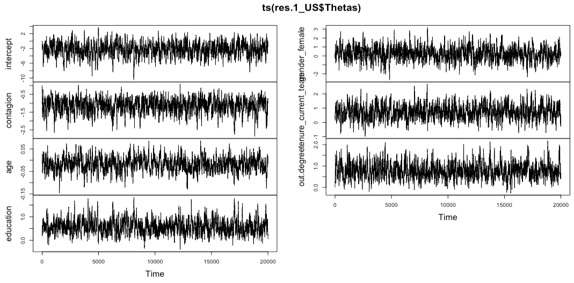
How can we improve ESS/SACF?
Increase iterations!
Or, use a better proposal covariance (see code comments)
Looks better?!

Slide 25
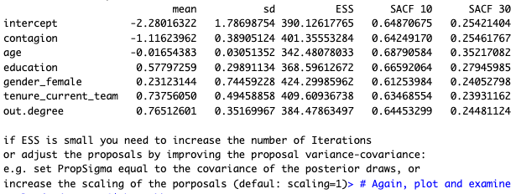
Model 1 - improved contagion model
Much better!

Slide 26
Testing Hypotheses
Yes
No
Similar to ERGM Lab
95% CI includes 0
Run a statistical test (i.e., ALAAM)
See 95% CI of the proper variable
Fail to reject the null hypothesis (don’t interpret the estimate)
Accept the proposed hypothesis & interpret the estimate
Sign of the estimate aligns with the proposed hypothesis?
Reject the null hypothesis
Reject the proposed hypothesis & interpret the estimate

Slide 27
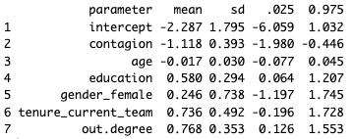
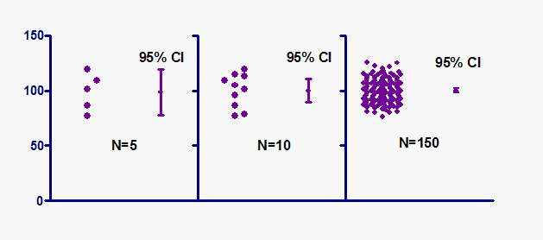
Testing Hypothesis 1
There is a positive contagion effect for knowledge hiding.
Check the 95% credibility interval (CI): Does it cross 0?
Is the sign of the estimate aligned with H1?
Interpret the estimate
0.975
mean
0.025

Slide 28
Interpret the estimate
Run exp(-1.118)
→ 0.326933
Exponential: odds ratio (if an odds ratio is 1, odds are even)
  U.S. employees who frequently communicate about work purposes with other knowledge-hiders are 0.328 times less likely to hide knowledge themselves than if they didn’t frequently communicate with other knowledge-hiders.

Slide 29
Interpret the estimate
Run exp(-1.118)/(1+exp(-1.118))
→ 0.2463825
Inverse logit (plogis): probability (random chance is 50%)
  The probability of US-based team members hiding knowledge is 24.6% if they frequently communicate about work purposes with other knowledge-hiders

Slide 30
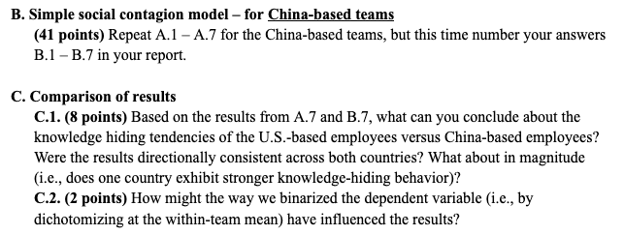
Repeat & Compare

Slide 31
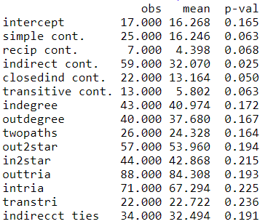
Goodness-of-fit Test
Which one indicates a good fit, p < .05 or p > .05?

